Slide 1

A PROJECT SYNOPSIS
ON
“WEBSITE ON FOOD ORDER SYSTEM”
Submitted to
SHIVAJI UNIVERSITY, KOLHAPUR

Slide 2
In partial fulfilment of the requirement for the degree of
BACHELOR OF COMPUTER APPLICATION
Submitted By
Sr.no | Roll no | Name of student
1 | 47 | Lohar Priyanka Santosh
2 | 73 | Sawant Pooja Laxman
3 | 75 | Shinde Nikhil Shashikant
4 | 76 | Shinde Rohan Shivaji

Slide 3
UNDER THE GUIDANCE OF Mr. V. D. Chavan Through The Director Of KARMAVEER BHAURAO PATIL INSTITUTE OF MANAGEMENT STUDIES AND RESEARCH, SATARA. Year 2021-22

Slide 4
ABSTRACT In this document the requirements specification for an online food ordering system designed. primarily for use in the food delivery industry. My system will allow restaurants to quickly and easily manage an online menu which customers can browse and use to place orders with just a few clicks. The system then relays these orders to restaurant employees through an easy to navigate graphical interface for efficient processing.

Slide 5
INTRODUCTION
Online restaurant service has become a necessity and is highly affordable. It can easily provide an online services without any mentioned efforts and generate huge profits.
Online food ordering system through internet or web is very essential as . internet is a major tool in bringing potential customers to the restaurant's web site.
More importantly, more than 80 percent of those who ordered meals on the Internet said they rated the experience as excellent.

Slide 6
PROBLEM STATEMENT
The Online Food Ordering Website deals with placing orders of food from various restaurants. This system involves the following functionalities:
The People have to be present condition in taken food from Hotel that means People had to compulsion of goes to Hotel.
Now the moment the Online food ordering could be called the response of the Internet to the desire for delivery food.
It is a growing trend especially in urban areas and on college campuses that allows people to order from restaurants featuring interactive menus, by use of their Internet connection.

Slide 7
SYSTEM ANALYSIS:
DFD (Data flow diagram)
ERD (Entity Relationship Diagram)

Slide 8
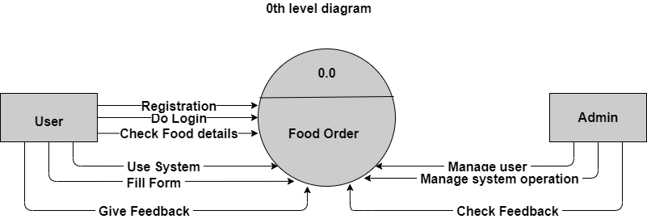
DFD (Data flow diagram)

Slide 9
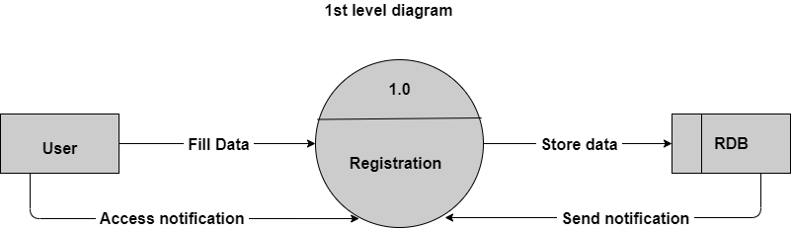
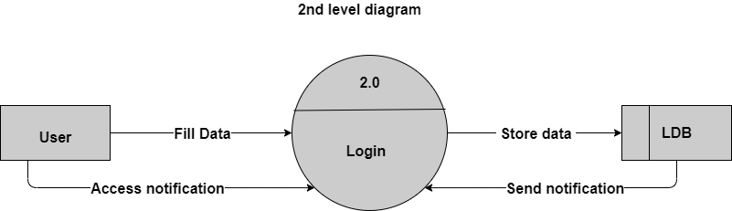

Slide 10
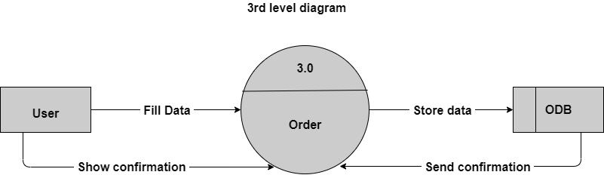


Slide 11
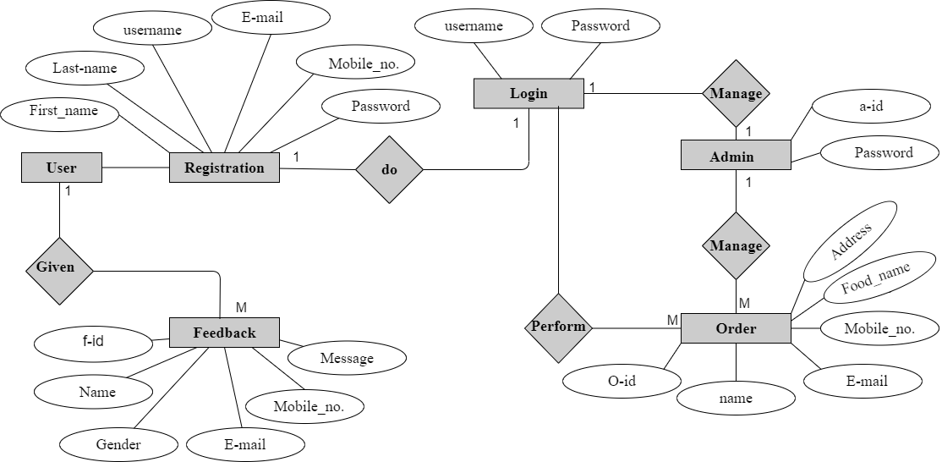
ERD (Entity Relationship Diagram)

Slide 12
ADVANTAGES
Makes managing orders simple
Manage entire business at one platform
Improves productivity
Keep track of the orders and deliveries
Complete analysis of your business
Increase sales and revenue
Daily and monthly revenue reports

Slide 13
DISADVANTAGES
Data security
Risk of losing customers data
Chances of a technical problem in the website
Mismatch data of orders, customers and drivers

Slide 14
LIMITATIONS
Require internet connectivity if user is ordering.
Require an any devices like PC, Laptop, Android.

Slide 15
USER INTERFACE
Passwords should be encrypted
Usability Requirement
The system should have a simple and easy-to-learn graphic user interfaces
Software interface:
Operating system: - windows, Linux, mac OS
Programming language: - Html, CSS, Java

Slide 16
FUTURE SCOPE
Easy use of customer
Computerized Entry Of Details.
User Friendly Interaction between User and website.
Easy access to any stage.
Security Provided.
Lot of time is getting saved.
Easy backup of data.
Easy access for exotic & authentic product.

Slide 17
CONCLUSION
The project undertaken by me at “KBPIMSR, Satara" helped me in not only gaining practical experience but also to adapt the organizational environments and procedures.
It is said that no system is perfect; every system has some limitations and flaws. Taking this into consideration, the project “Online Food Order” has been carried out successfully.
Thus I confidently conclude that this was not only beneficial in its technical and educational aspect but also wins equality in building up my personality.

